Slide 1
The Grammar school of Zrenjanin

Slide 2
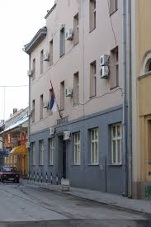
Our school was founded in 1846.
Now
Then

Slide 3
Today, it’s one of the biggest grammar school in Serbia. It holds approximately 1300 students and 116 employees.

Slide 4
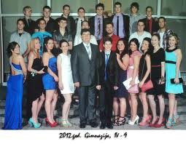
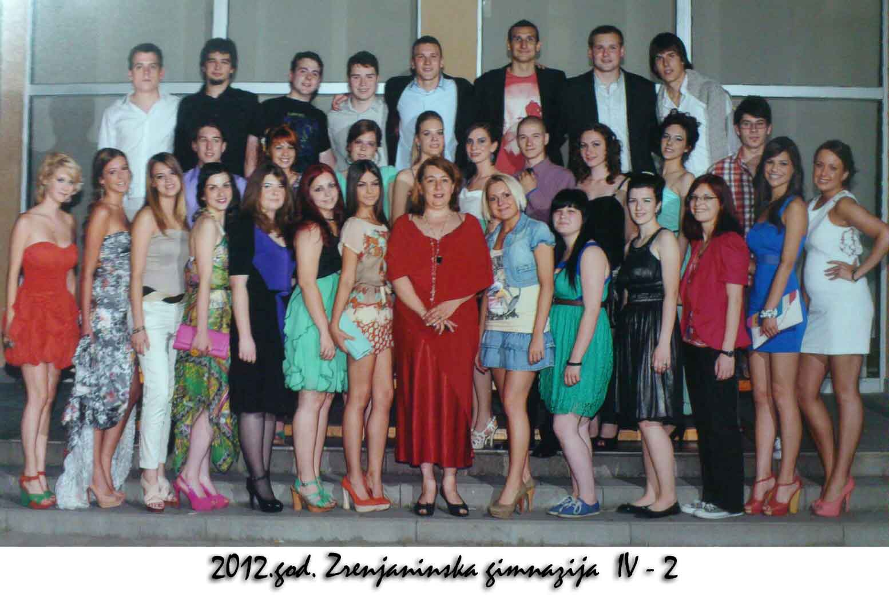
Prom nights:

Slide 5
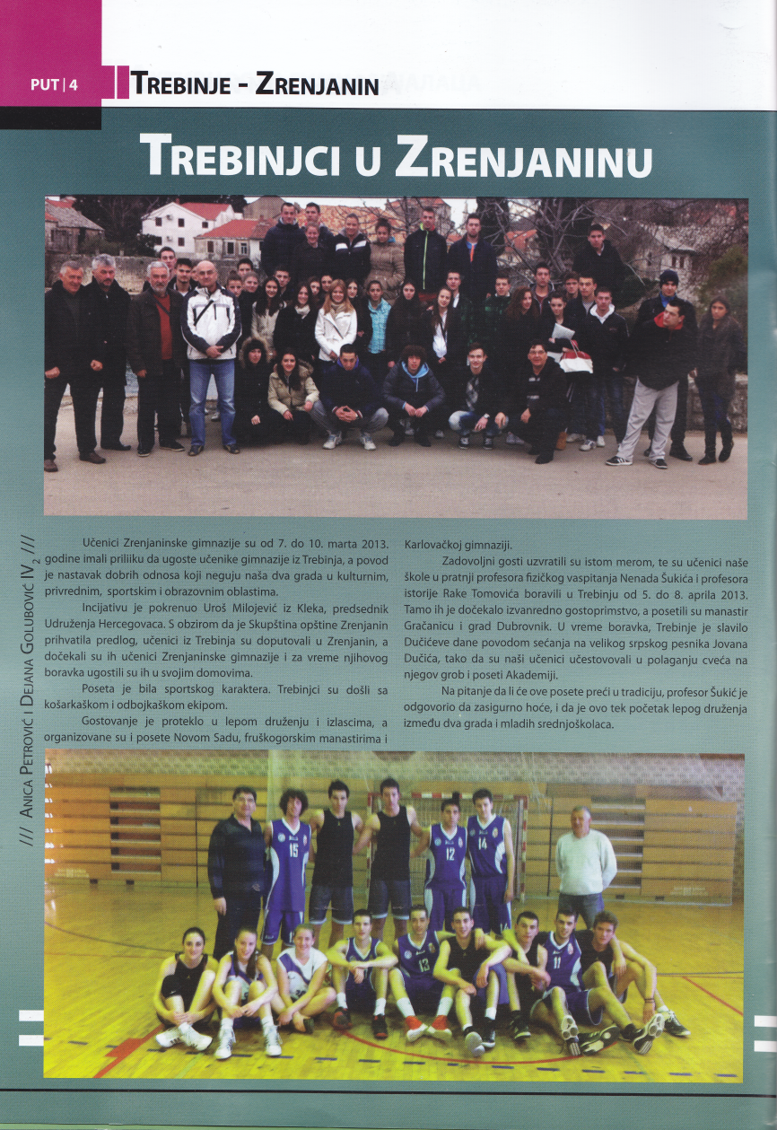
Our school paper: ‘’Put ‘’(road)

Slide 6
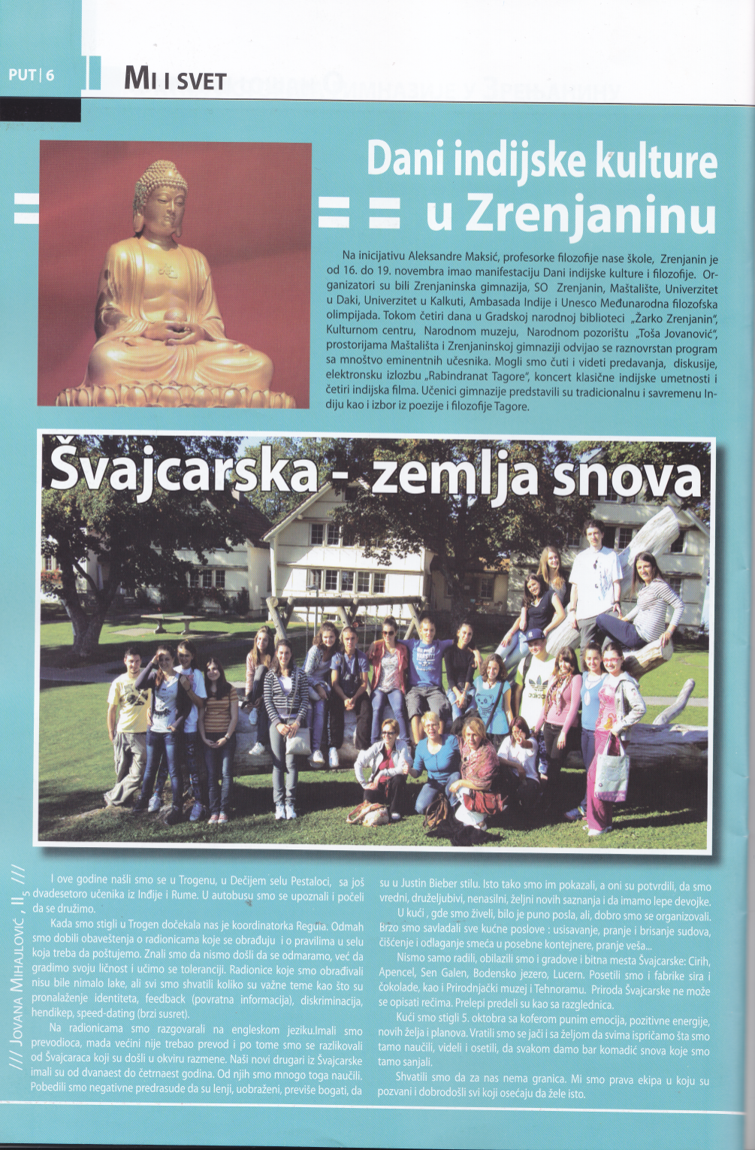

Slide 7
It talk’s about all of our school activities. From sports, traveling and international co-operations to news and fun work shops.

Slide 8
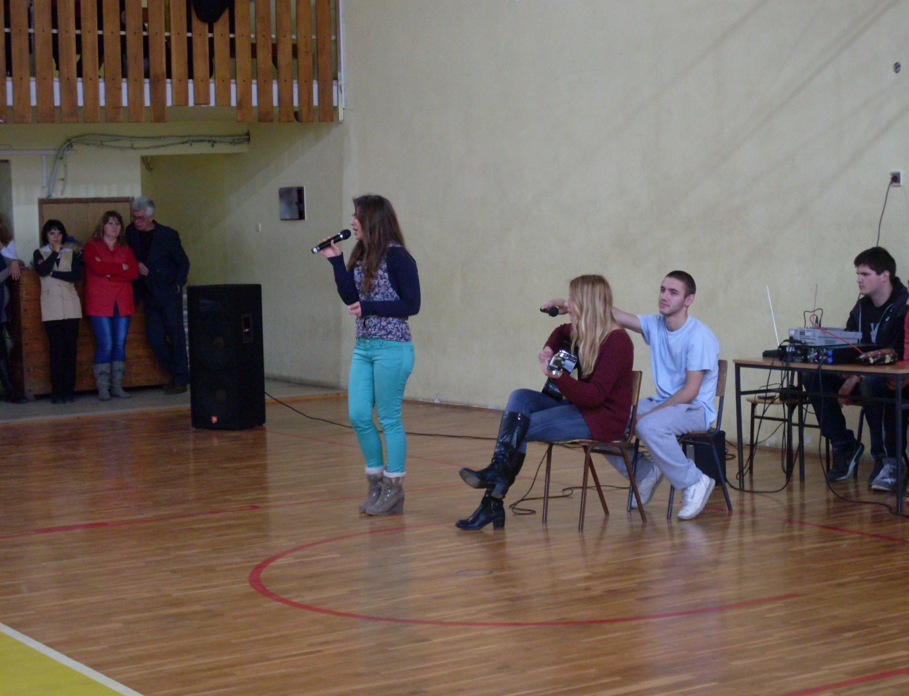
Our school makes celebrations and events in which students sing, dance, act, play instruments and have fun

Slide 9
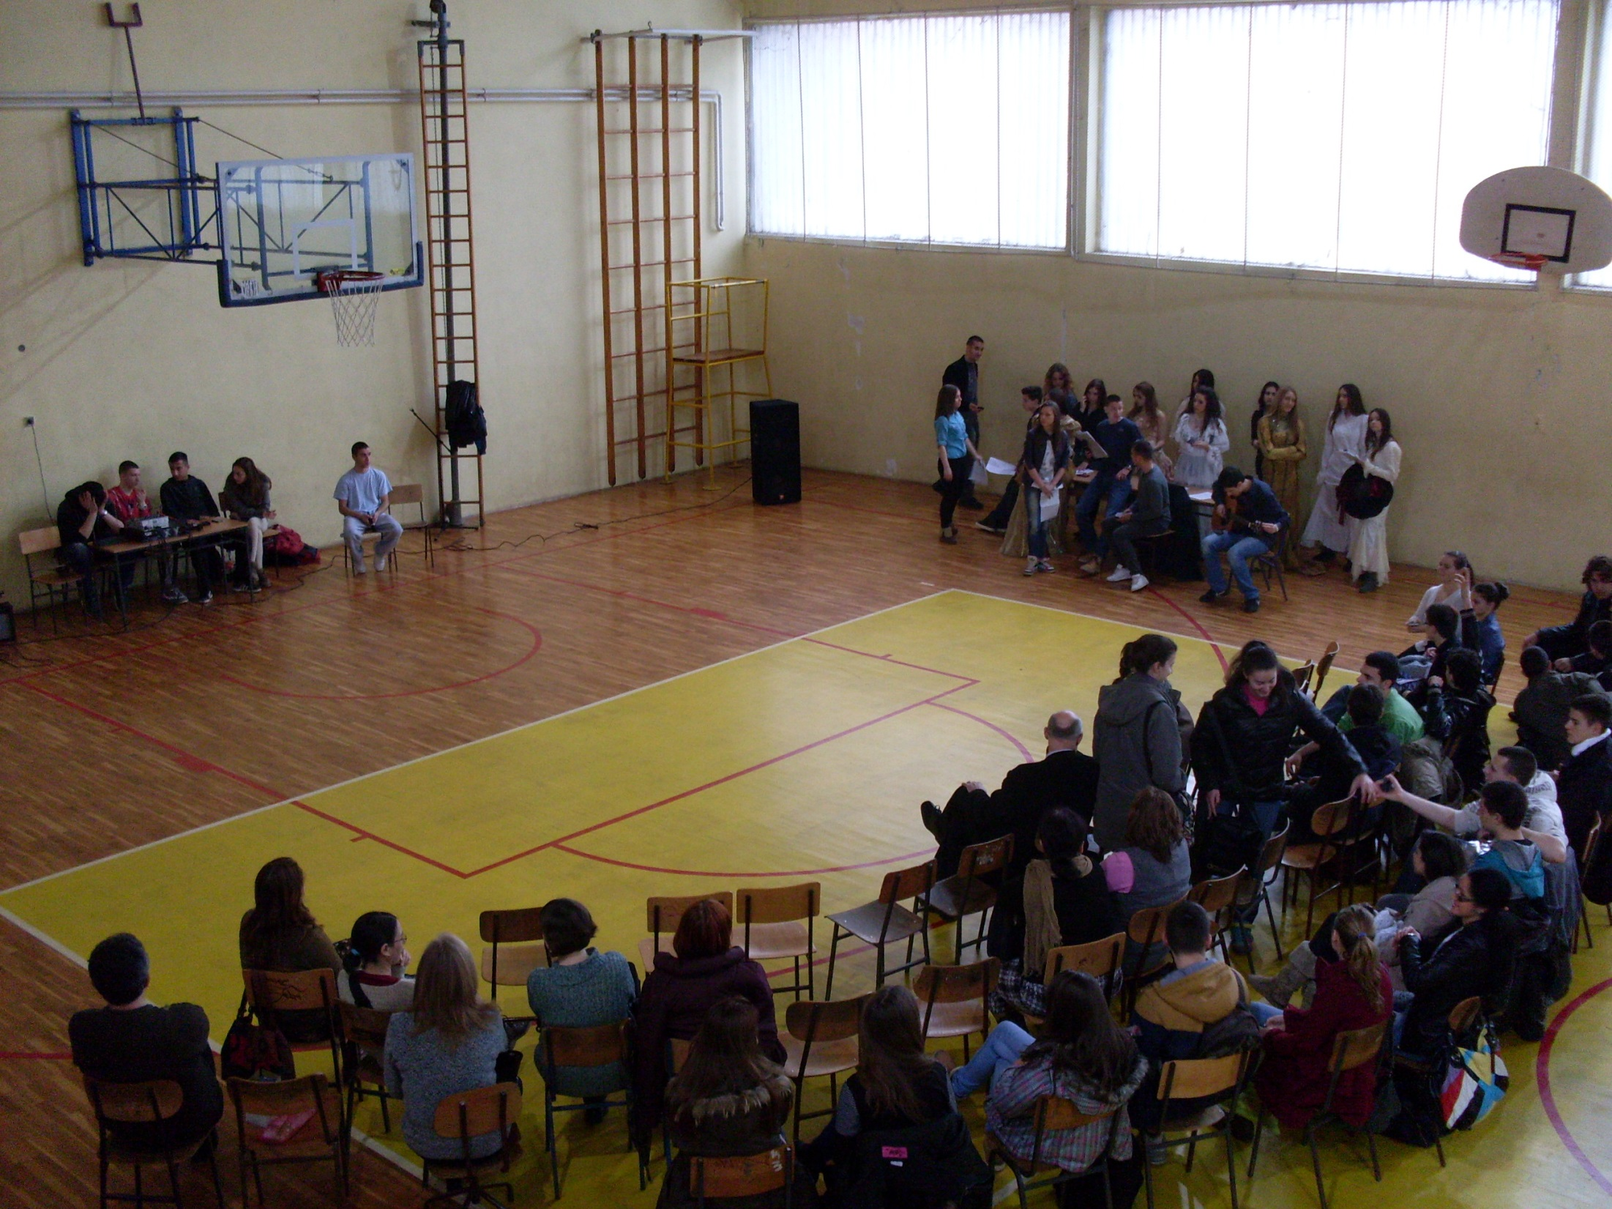

Slide 10
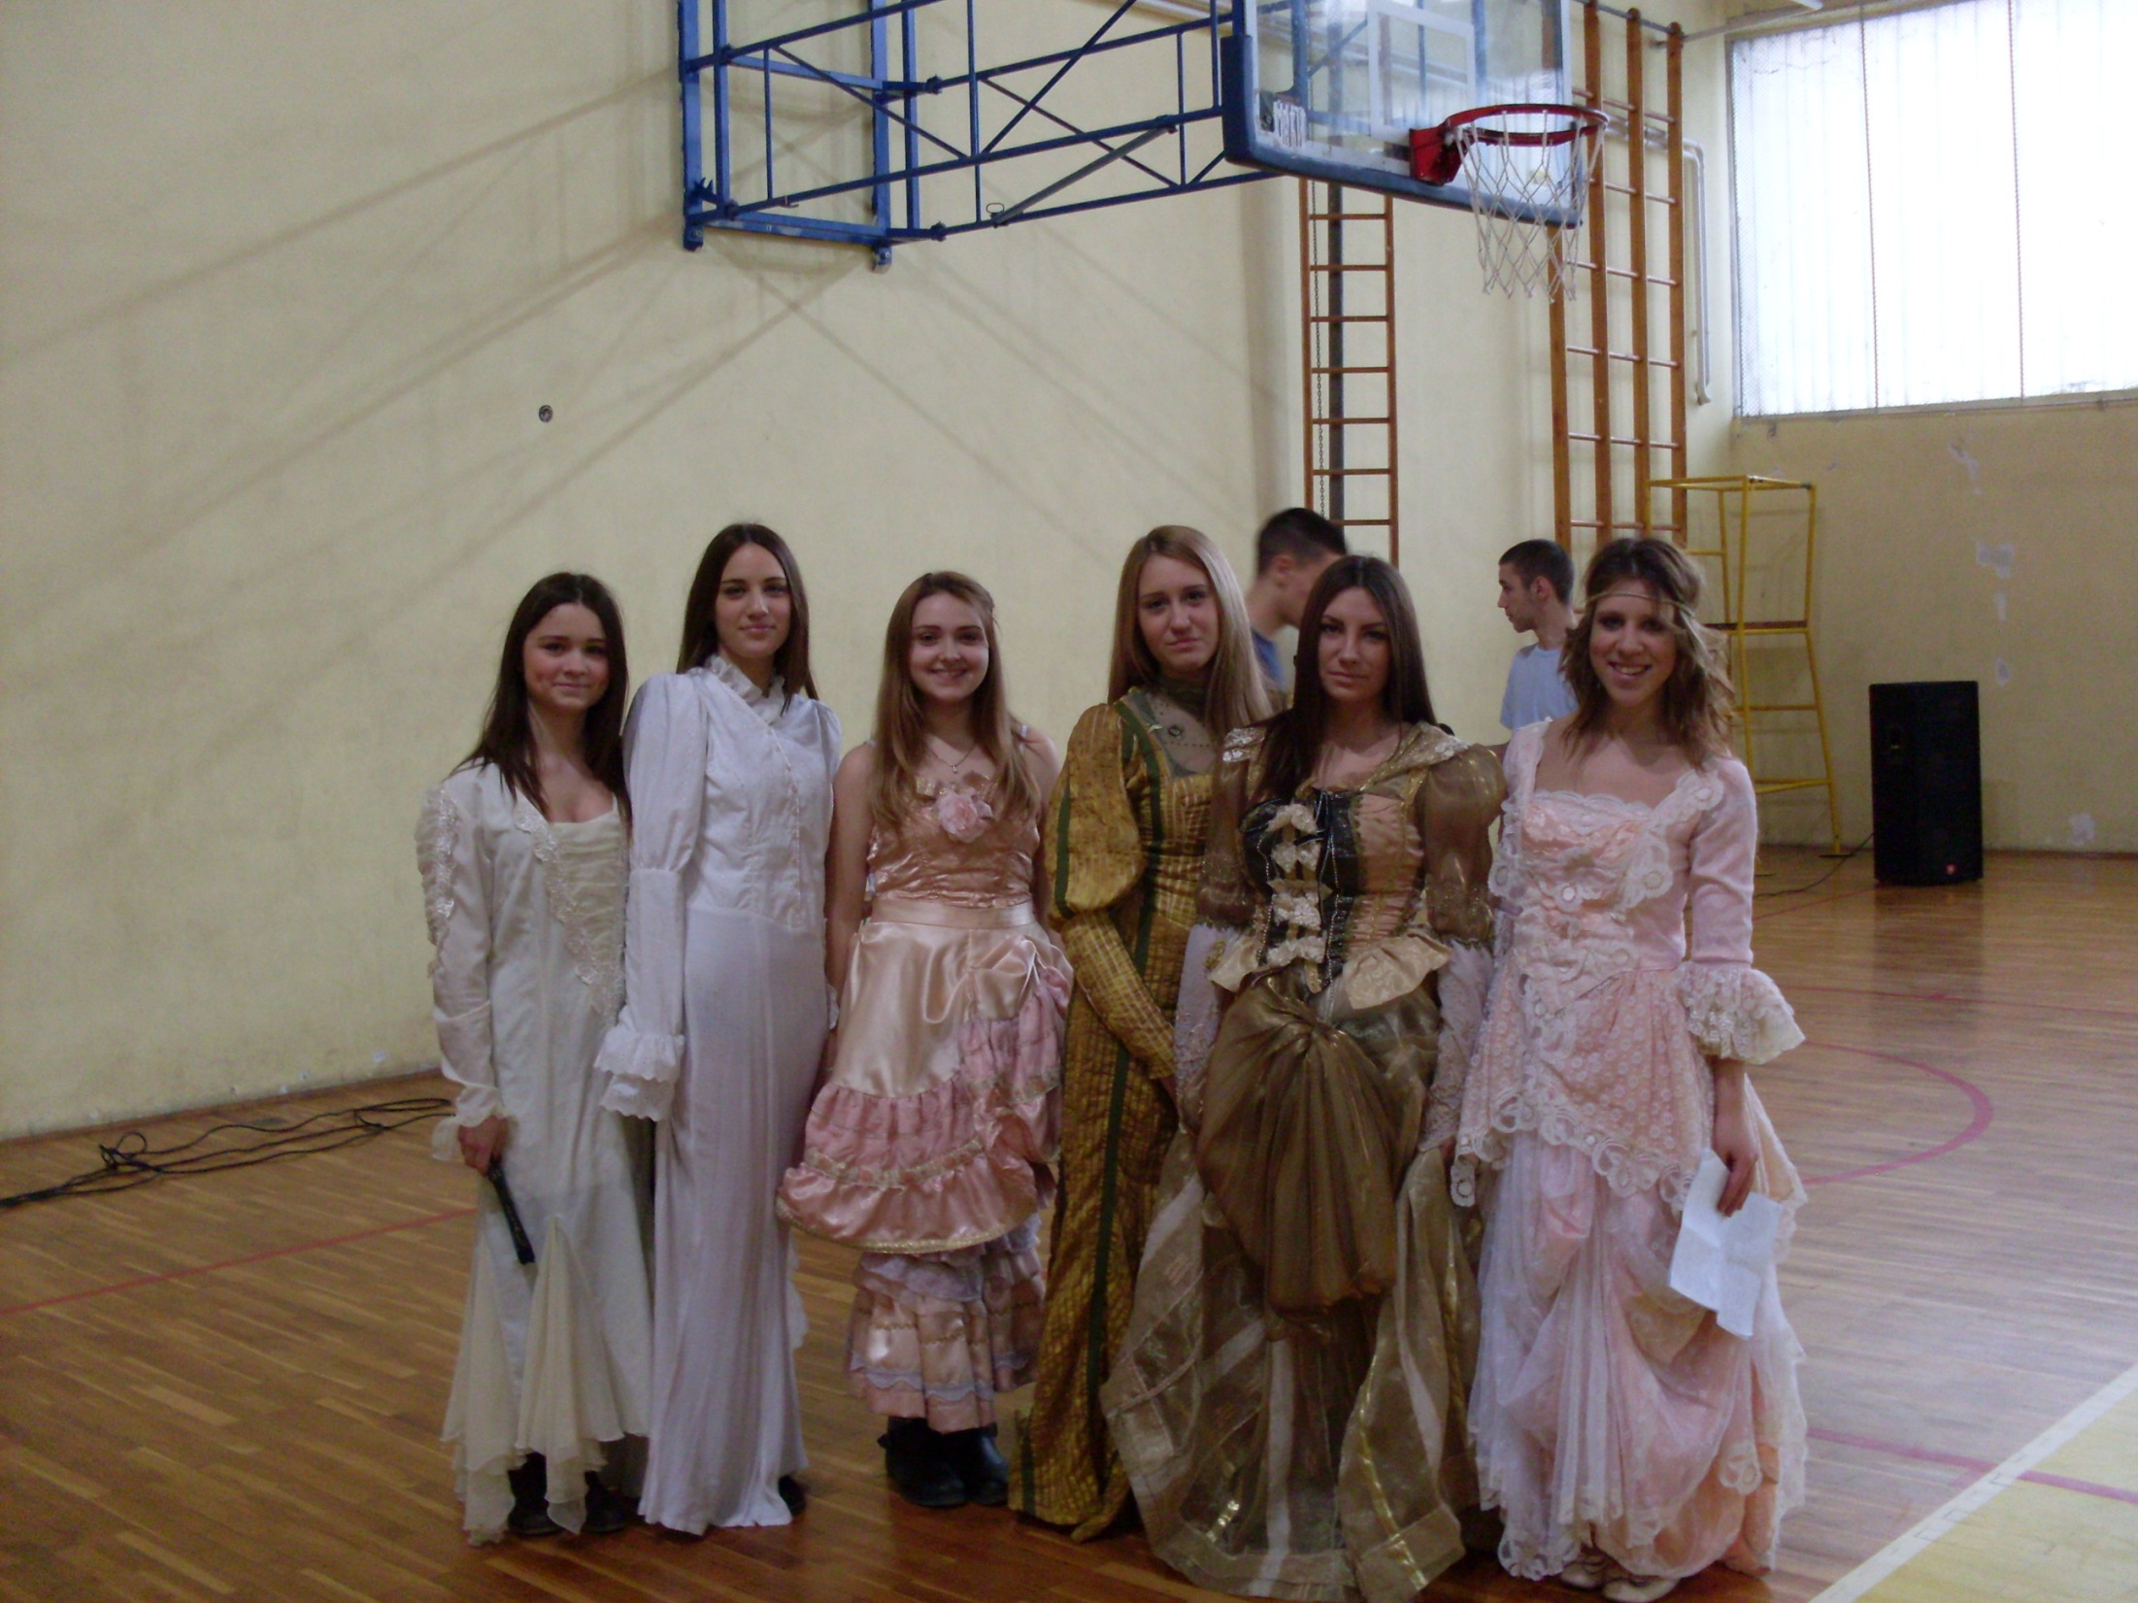

Slide 11
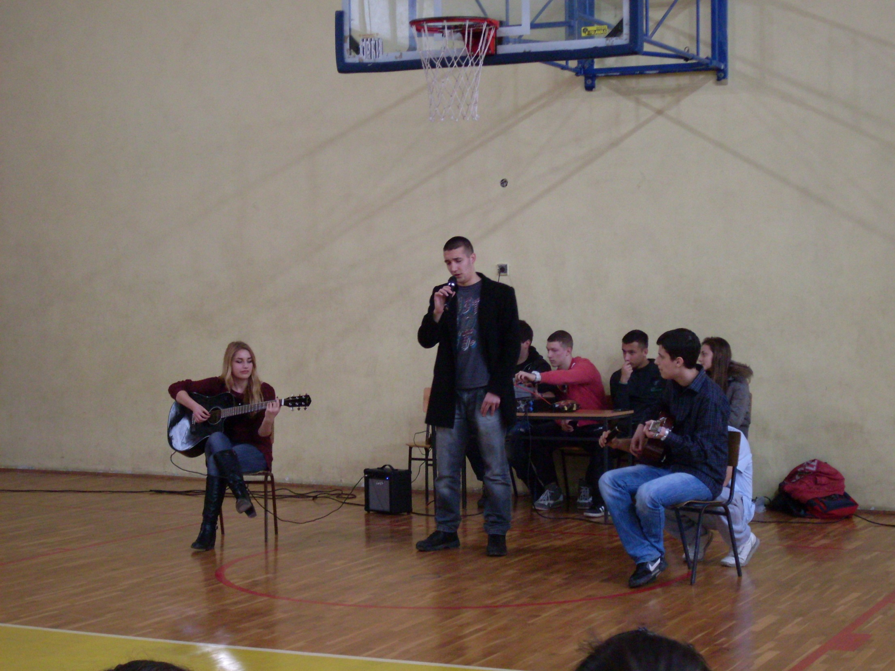

Slide 12
Our teachers sacrifice their personal hours just to give us a chance to learn more

Slide 13
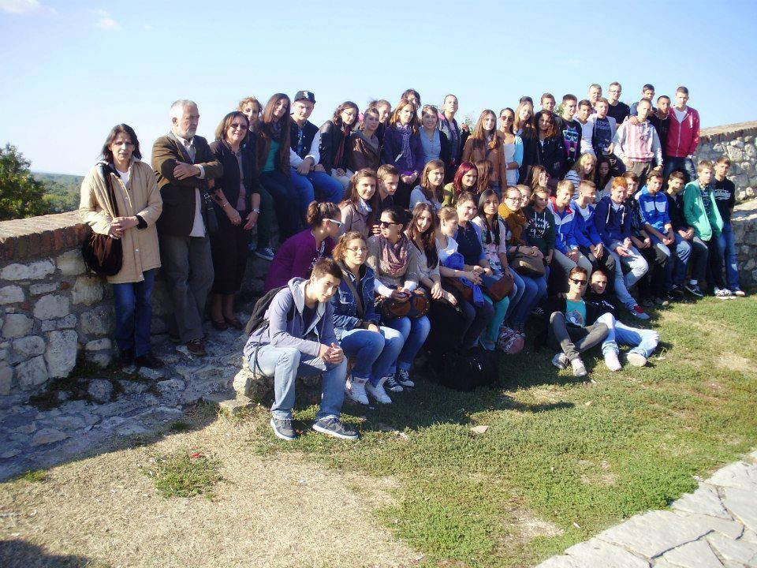
We love to travel

Slide 14
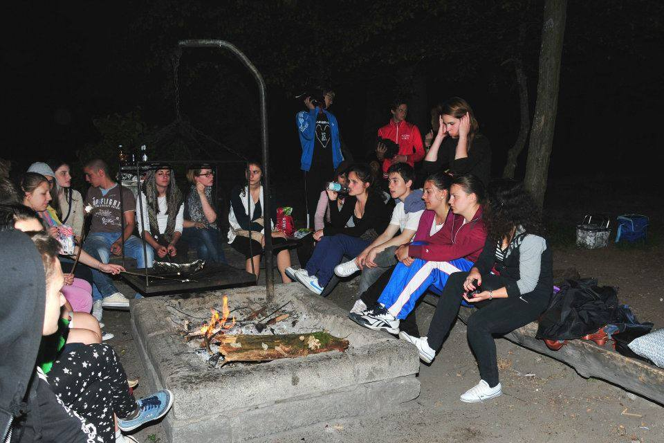

Slide 15
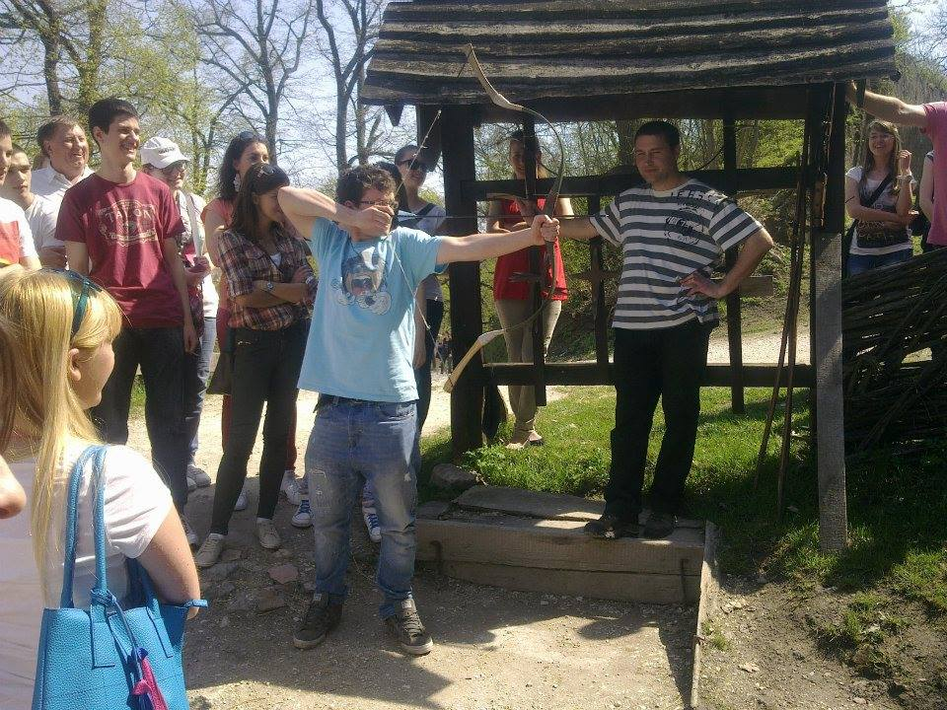

Slide 16
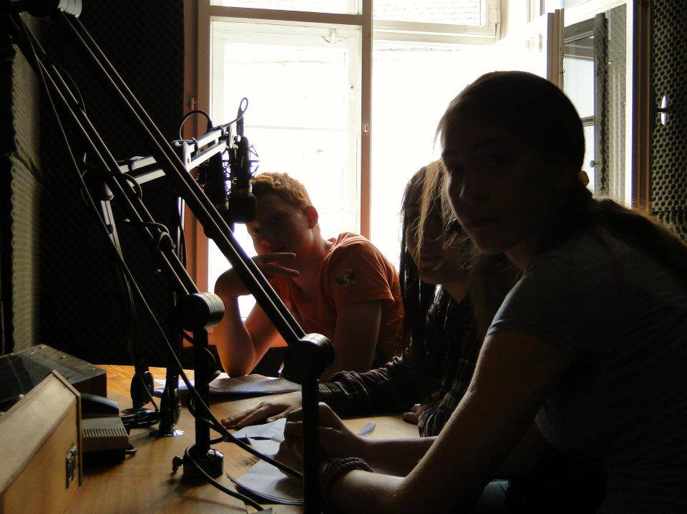

Slide 17
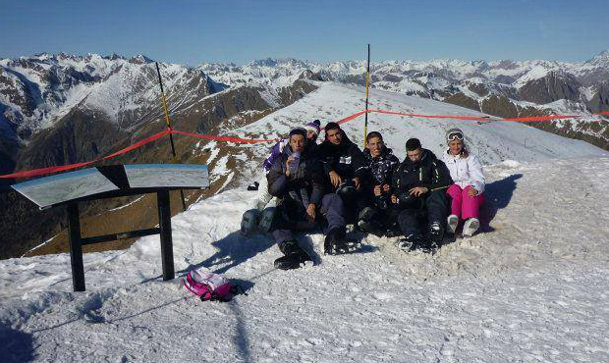
And skiing !

Slide 18
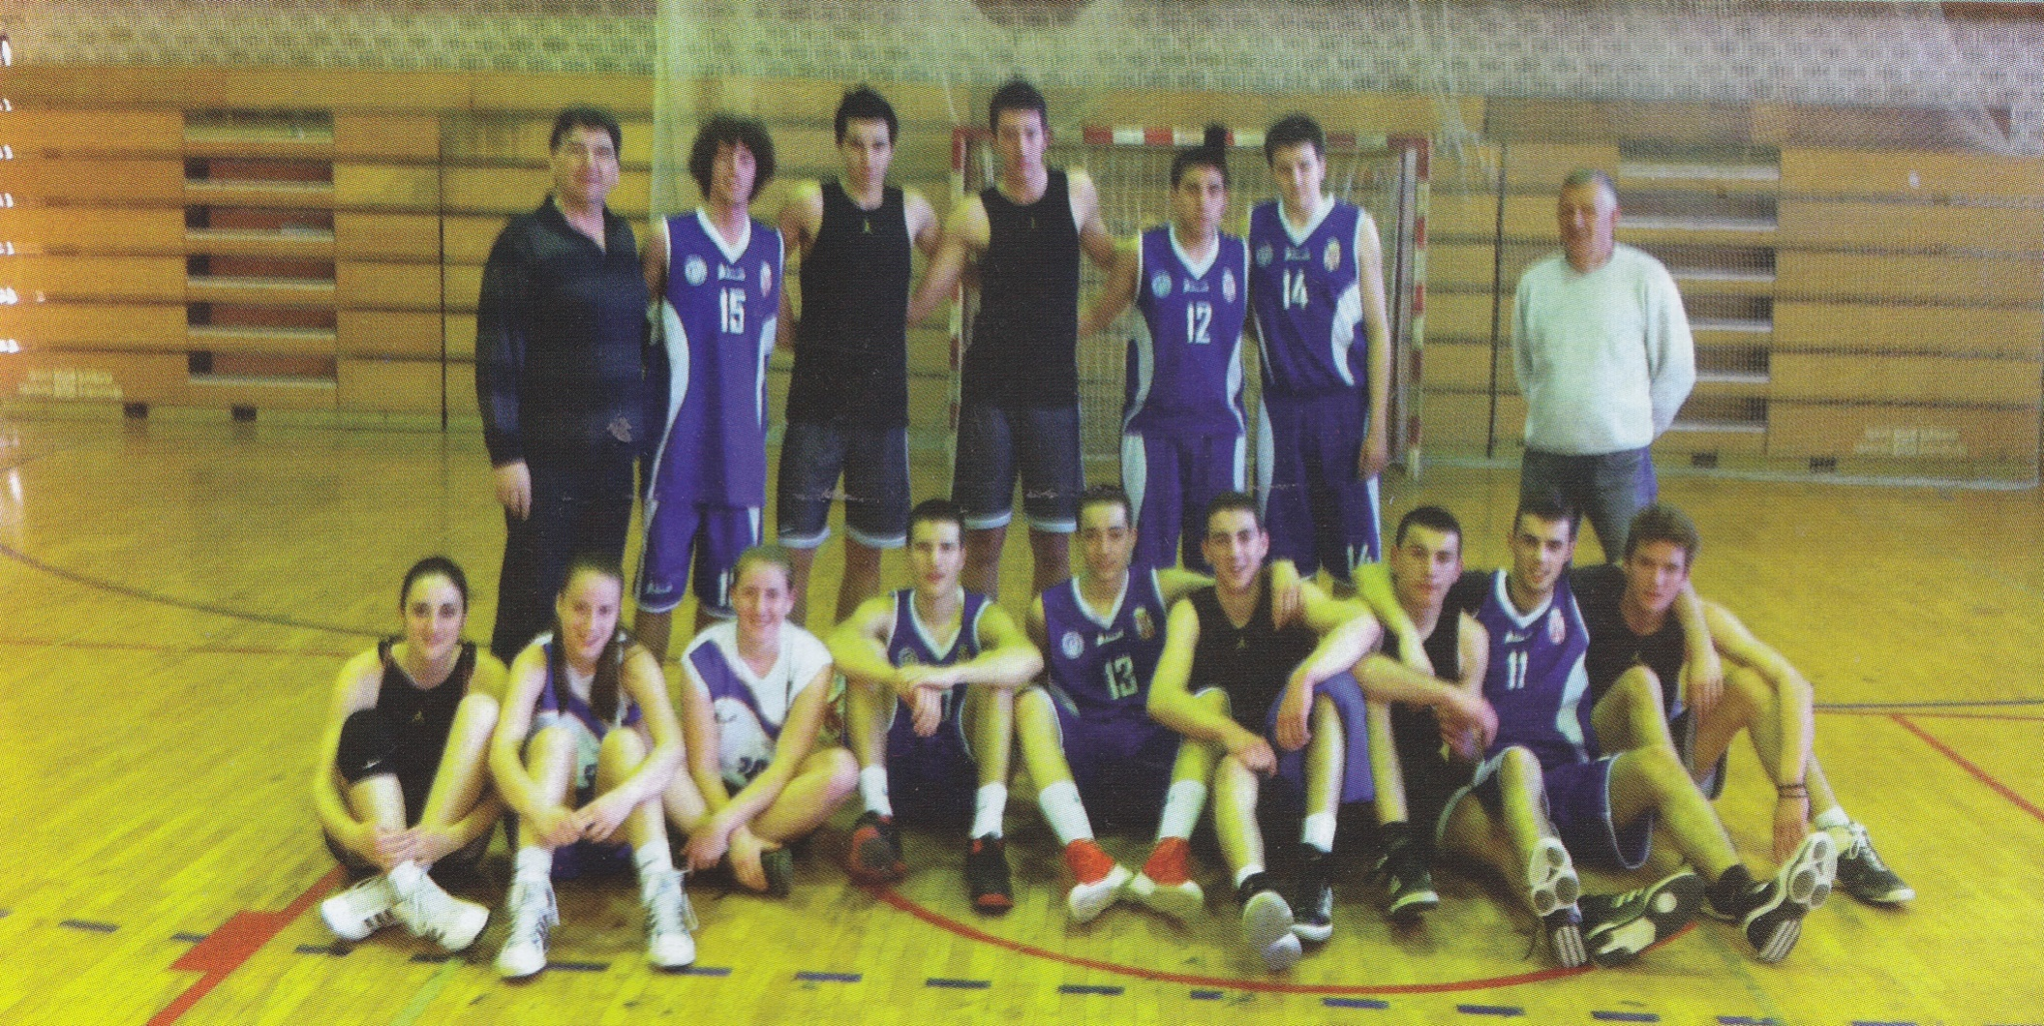
OUR BASKETBALL TEAM

Slide 19
Our students with our friends from a Belgrade Grammar school

Slide 20
We, the students, give back to the community. We help our fellow citizens with events like this one, organized by our biology teacher, by donating blood

Slide 22
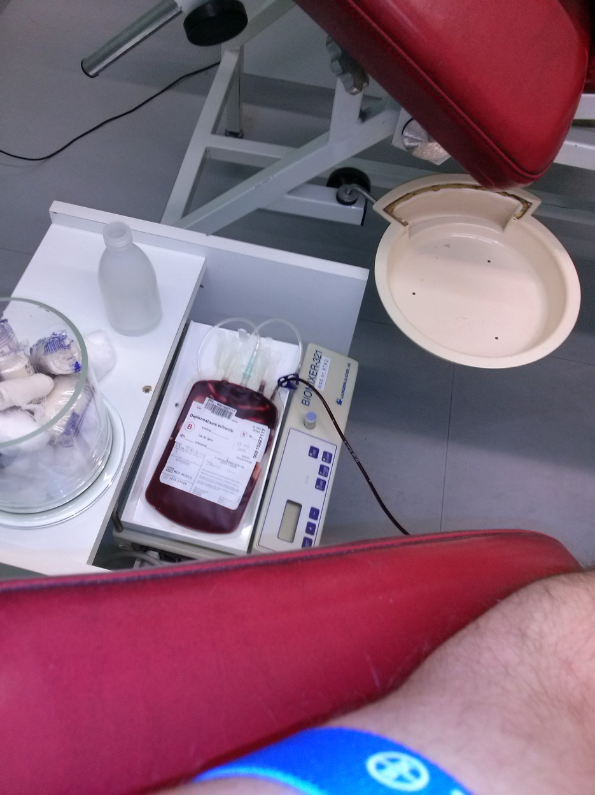
We know this is important because with every donation we help at least 4 people

Slide 23
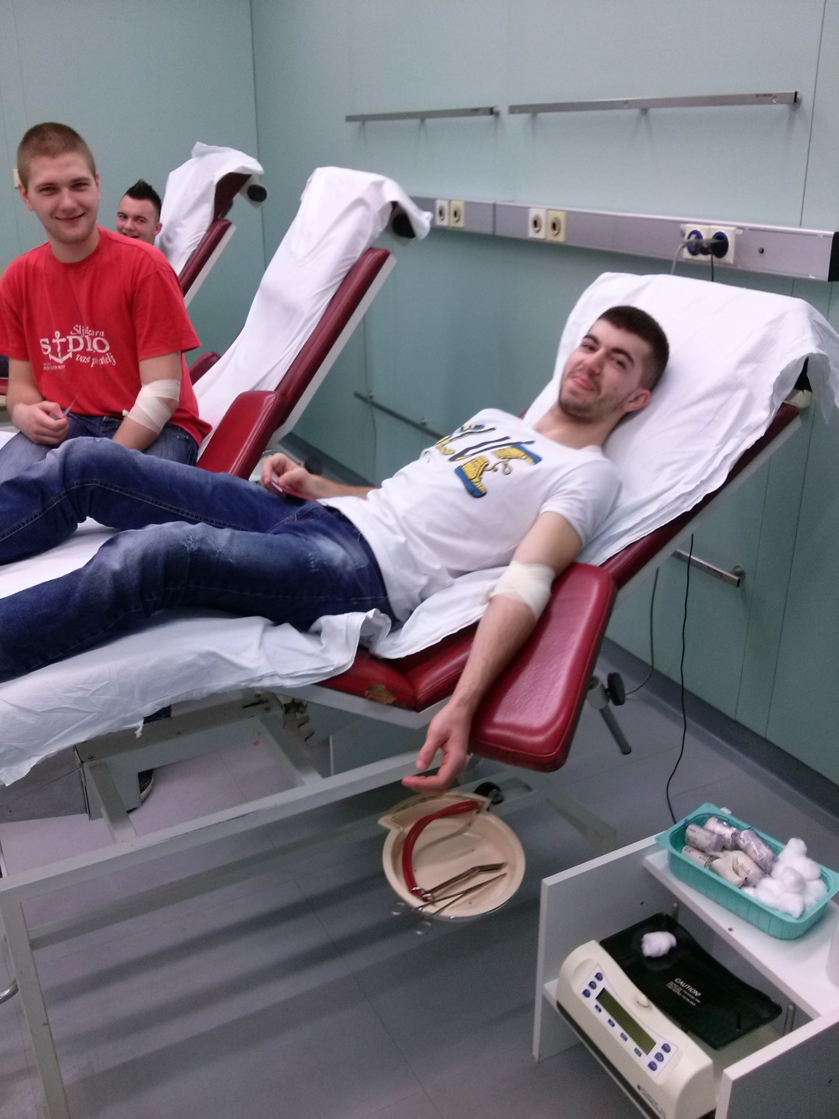
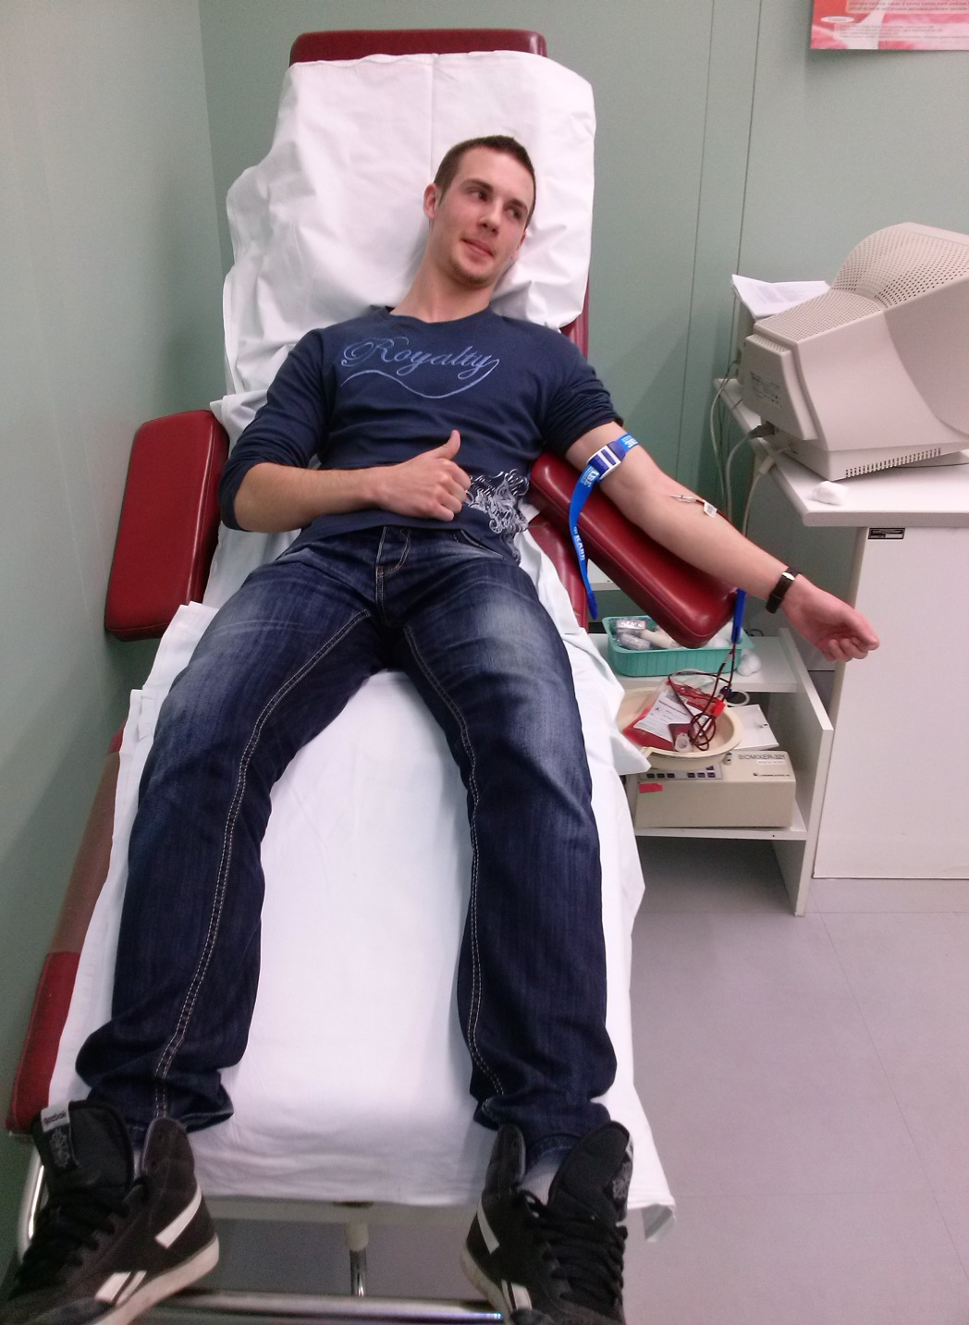
And get 2 days free of school ! :D

Slide 24
Dodacu ja jos ovde samo mi recite sve, ako je ovo vama ok (mada stv mislim da mozemo lako da nadjemo jos materijala) onda cu da je dovrsim tj napisem kraj pozdravi I to je to, I dacu oliveri da mi proveri pravopis

