Slide 1
A United Future
BORDERLESS CLASSROOMS

Slide 2
How Did The Project Evolve
Met at last year’s CSA, in Berlin
Wanted to create a project to challenge student stereotypes, and expose them to the world.
Challenges:
Different curriculum
Required vs volunteer participation
Other teaching obligations (testing)

Slide 3
Real School/Virtual “School”
Participating schools:
Zrenjanin Grammar School,
“Servo Mihalj” Primary School, Zrenjanin
“Bora Stankovic” Grammar School,
“Dusan Radovic” Primary School, Nis, Serbia
Palm Beach Central High School, Wellington, FL
Two FB Groups:
Society through a Digital Lens
Serbia/Florida Student Project

Slide 4
Introducing Ourselves
Introductory videos:
Created closed Facebook (FB) groups
Introductions to schools
Basketball challenges
Communicating in real time with cell phones.
What did they learn?
Cultural differences (race, interests)
Students got to know each other
Seeing other teens: similarities

Slide 6
Introduction Videos
Welcome to Central Presentation (1).pptx
Video Postcard from Serbia
The Hogwarts

Slide 7
CENTROPA: THE COMMON DENOMINATOR
We chose Centropa’s film Three Promises: The Story of the Kalefs of Belgrade as the film all classes would watch.
Posted discussion questions on FB for students

Slide 8
Cross-cultural Projects
The Basketball Challenge
Interviewing Holocaust Survivors

Slide 9
Interviewing Survivors
We interviewed survivors from each country.
The Serbian students shared their experiences with the Central HS students in Florida.
This opened a conversation at Central about the differences in post-war experiences of Holocaust survivors.

Slide 10
Senka, students and survivor

Slide 11
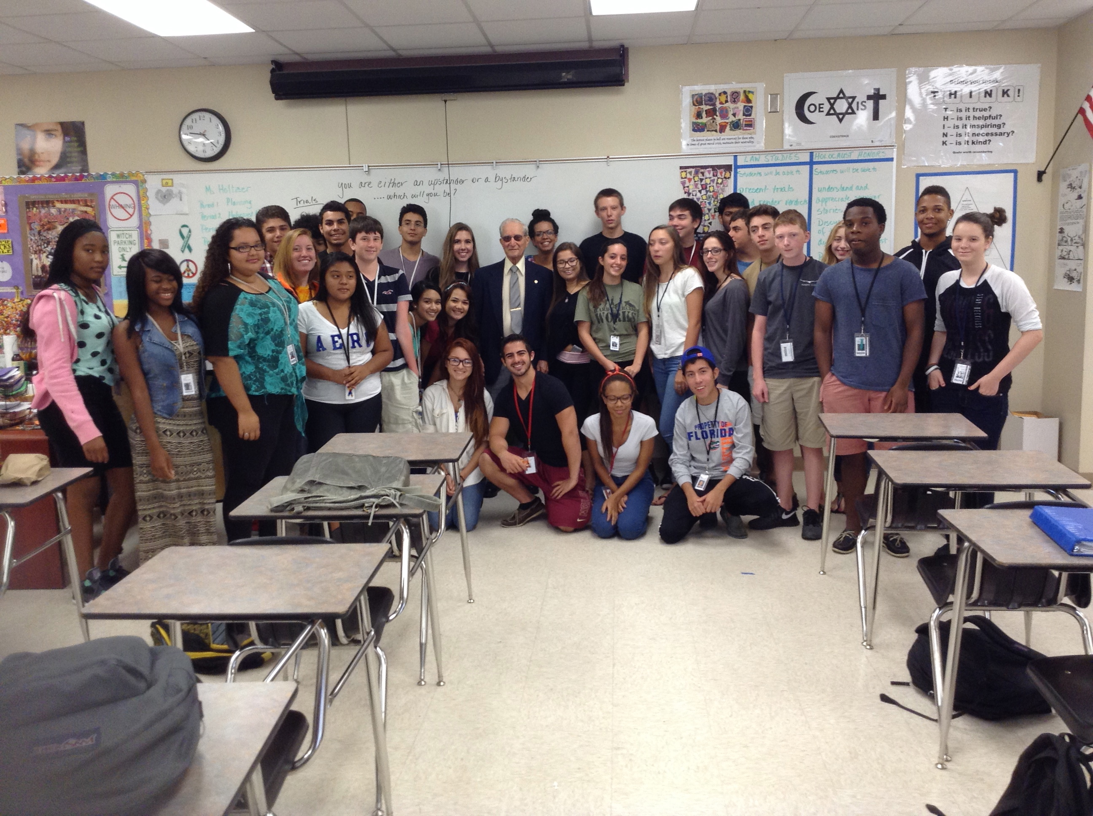
PICTURE OF CLASSES WITH THEIR SURVIVOR
Senka’s Classes and Maureen’s Classes

Slide 12
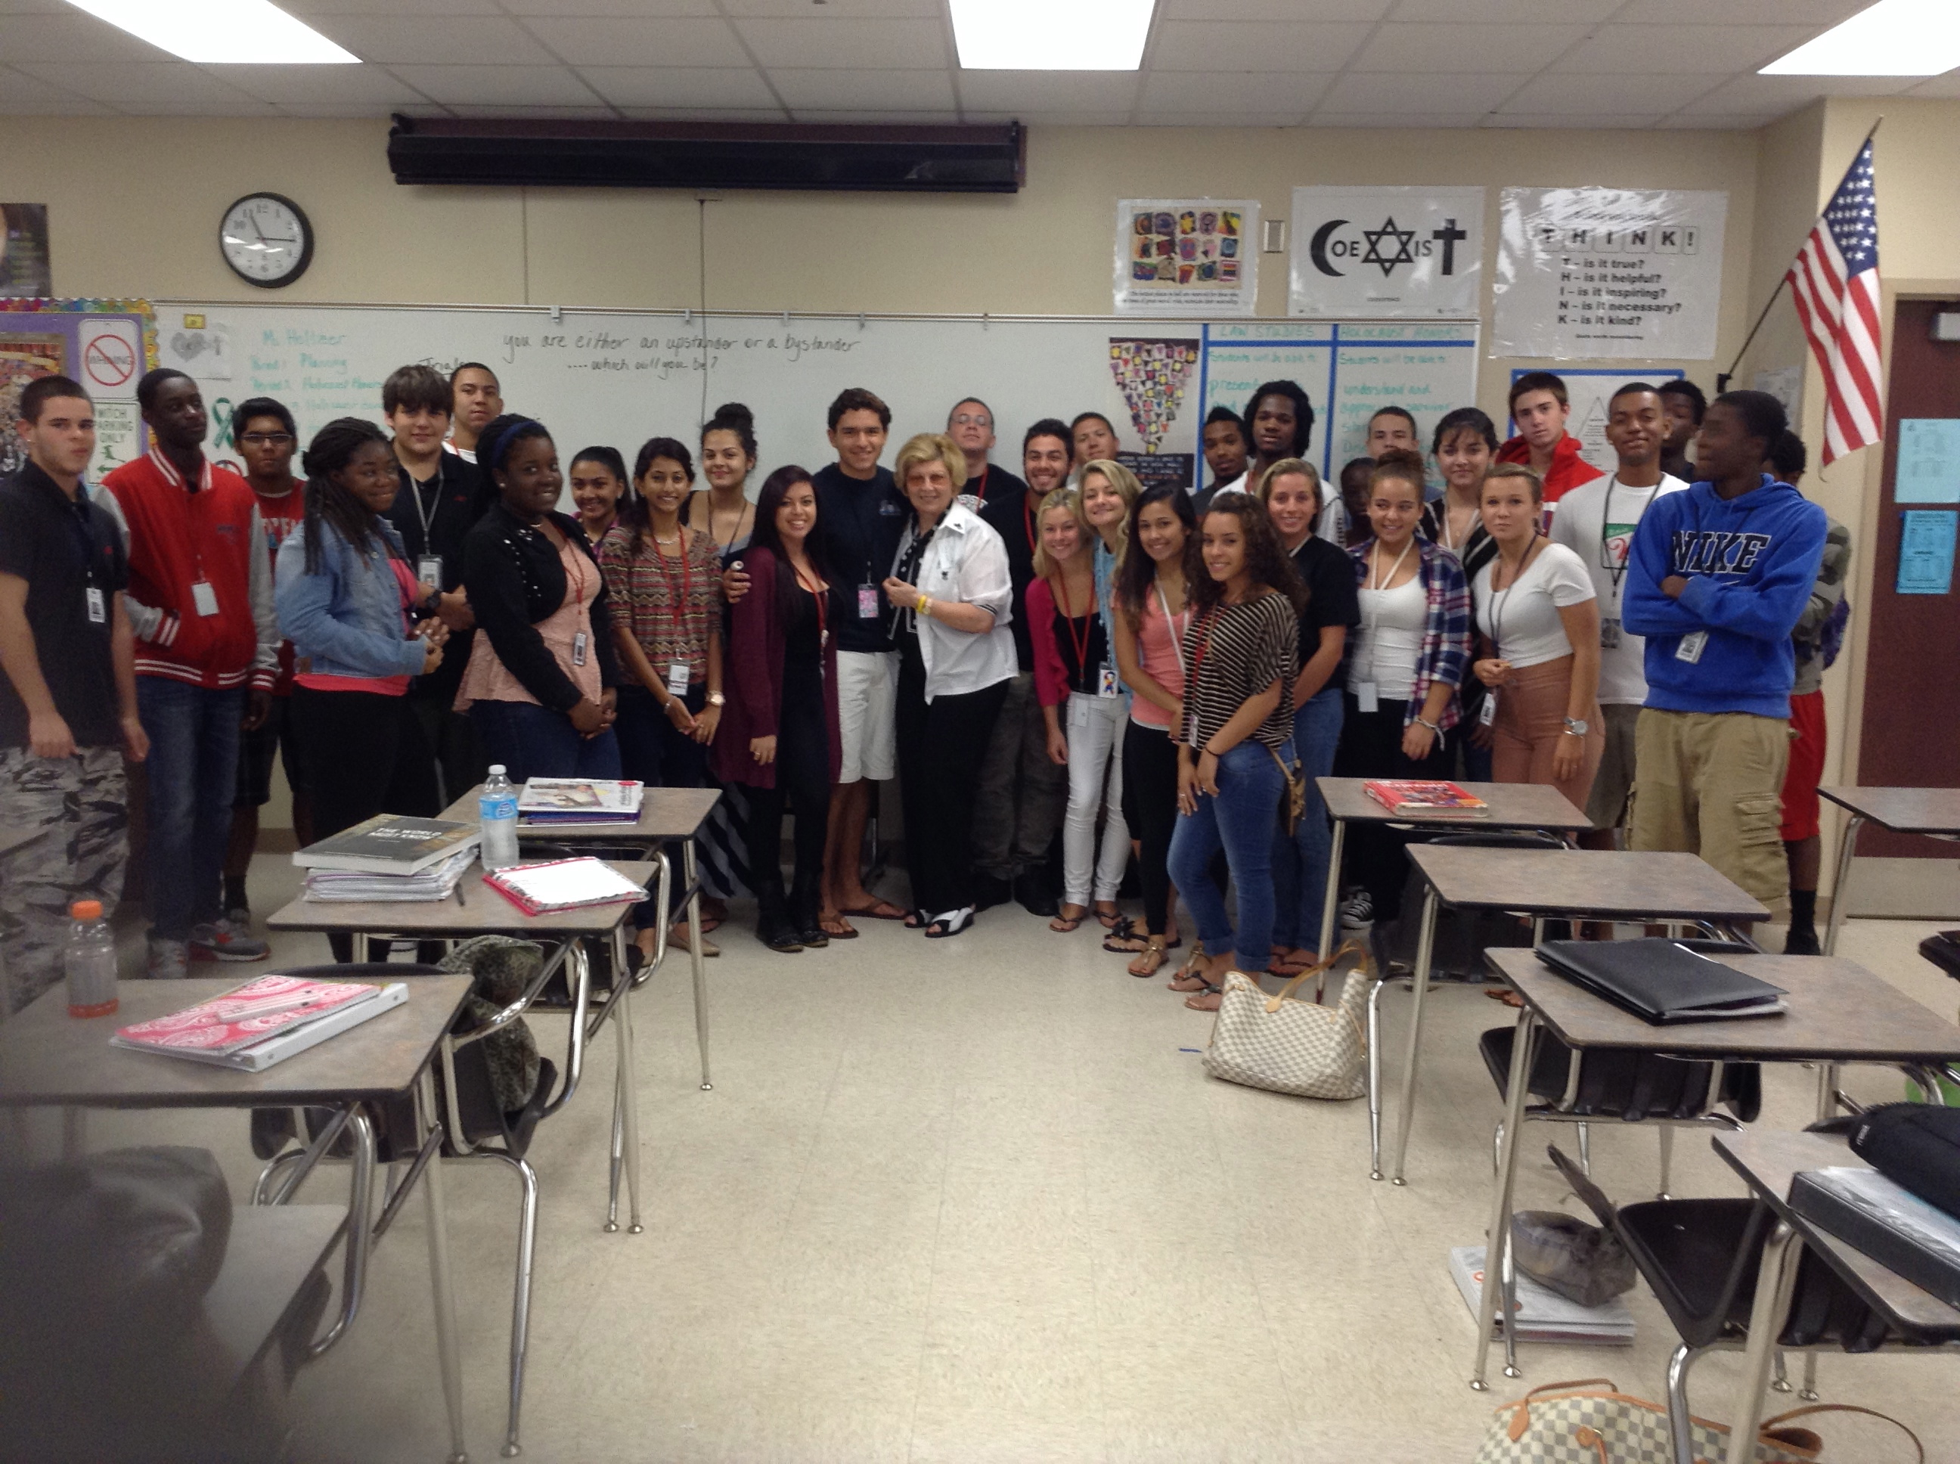
PICTURES OF CENTRAL KIDS WITH SURVIVORS

Slide 13
Marko & his students

Slide 14
Lessons Learned
Centuries of history vs diversity
Common (teenage) interests
Intolerance in other societies
Jewish stories/Holocaust/Centropa

Slide 15
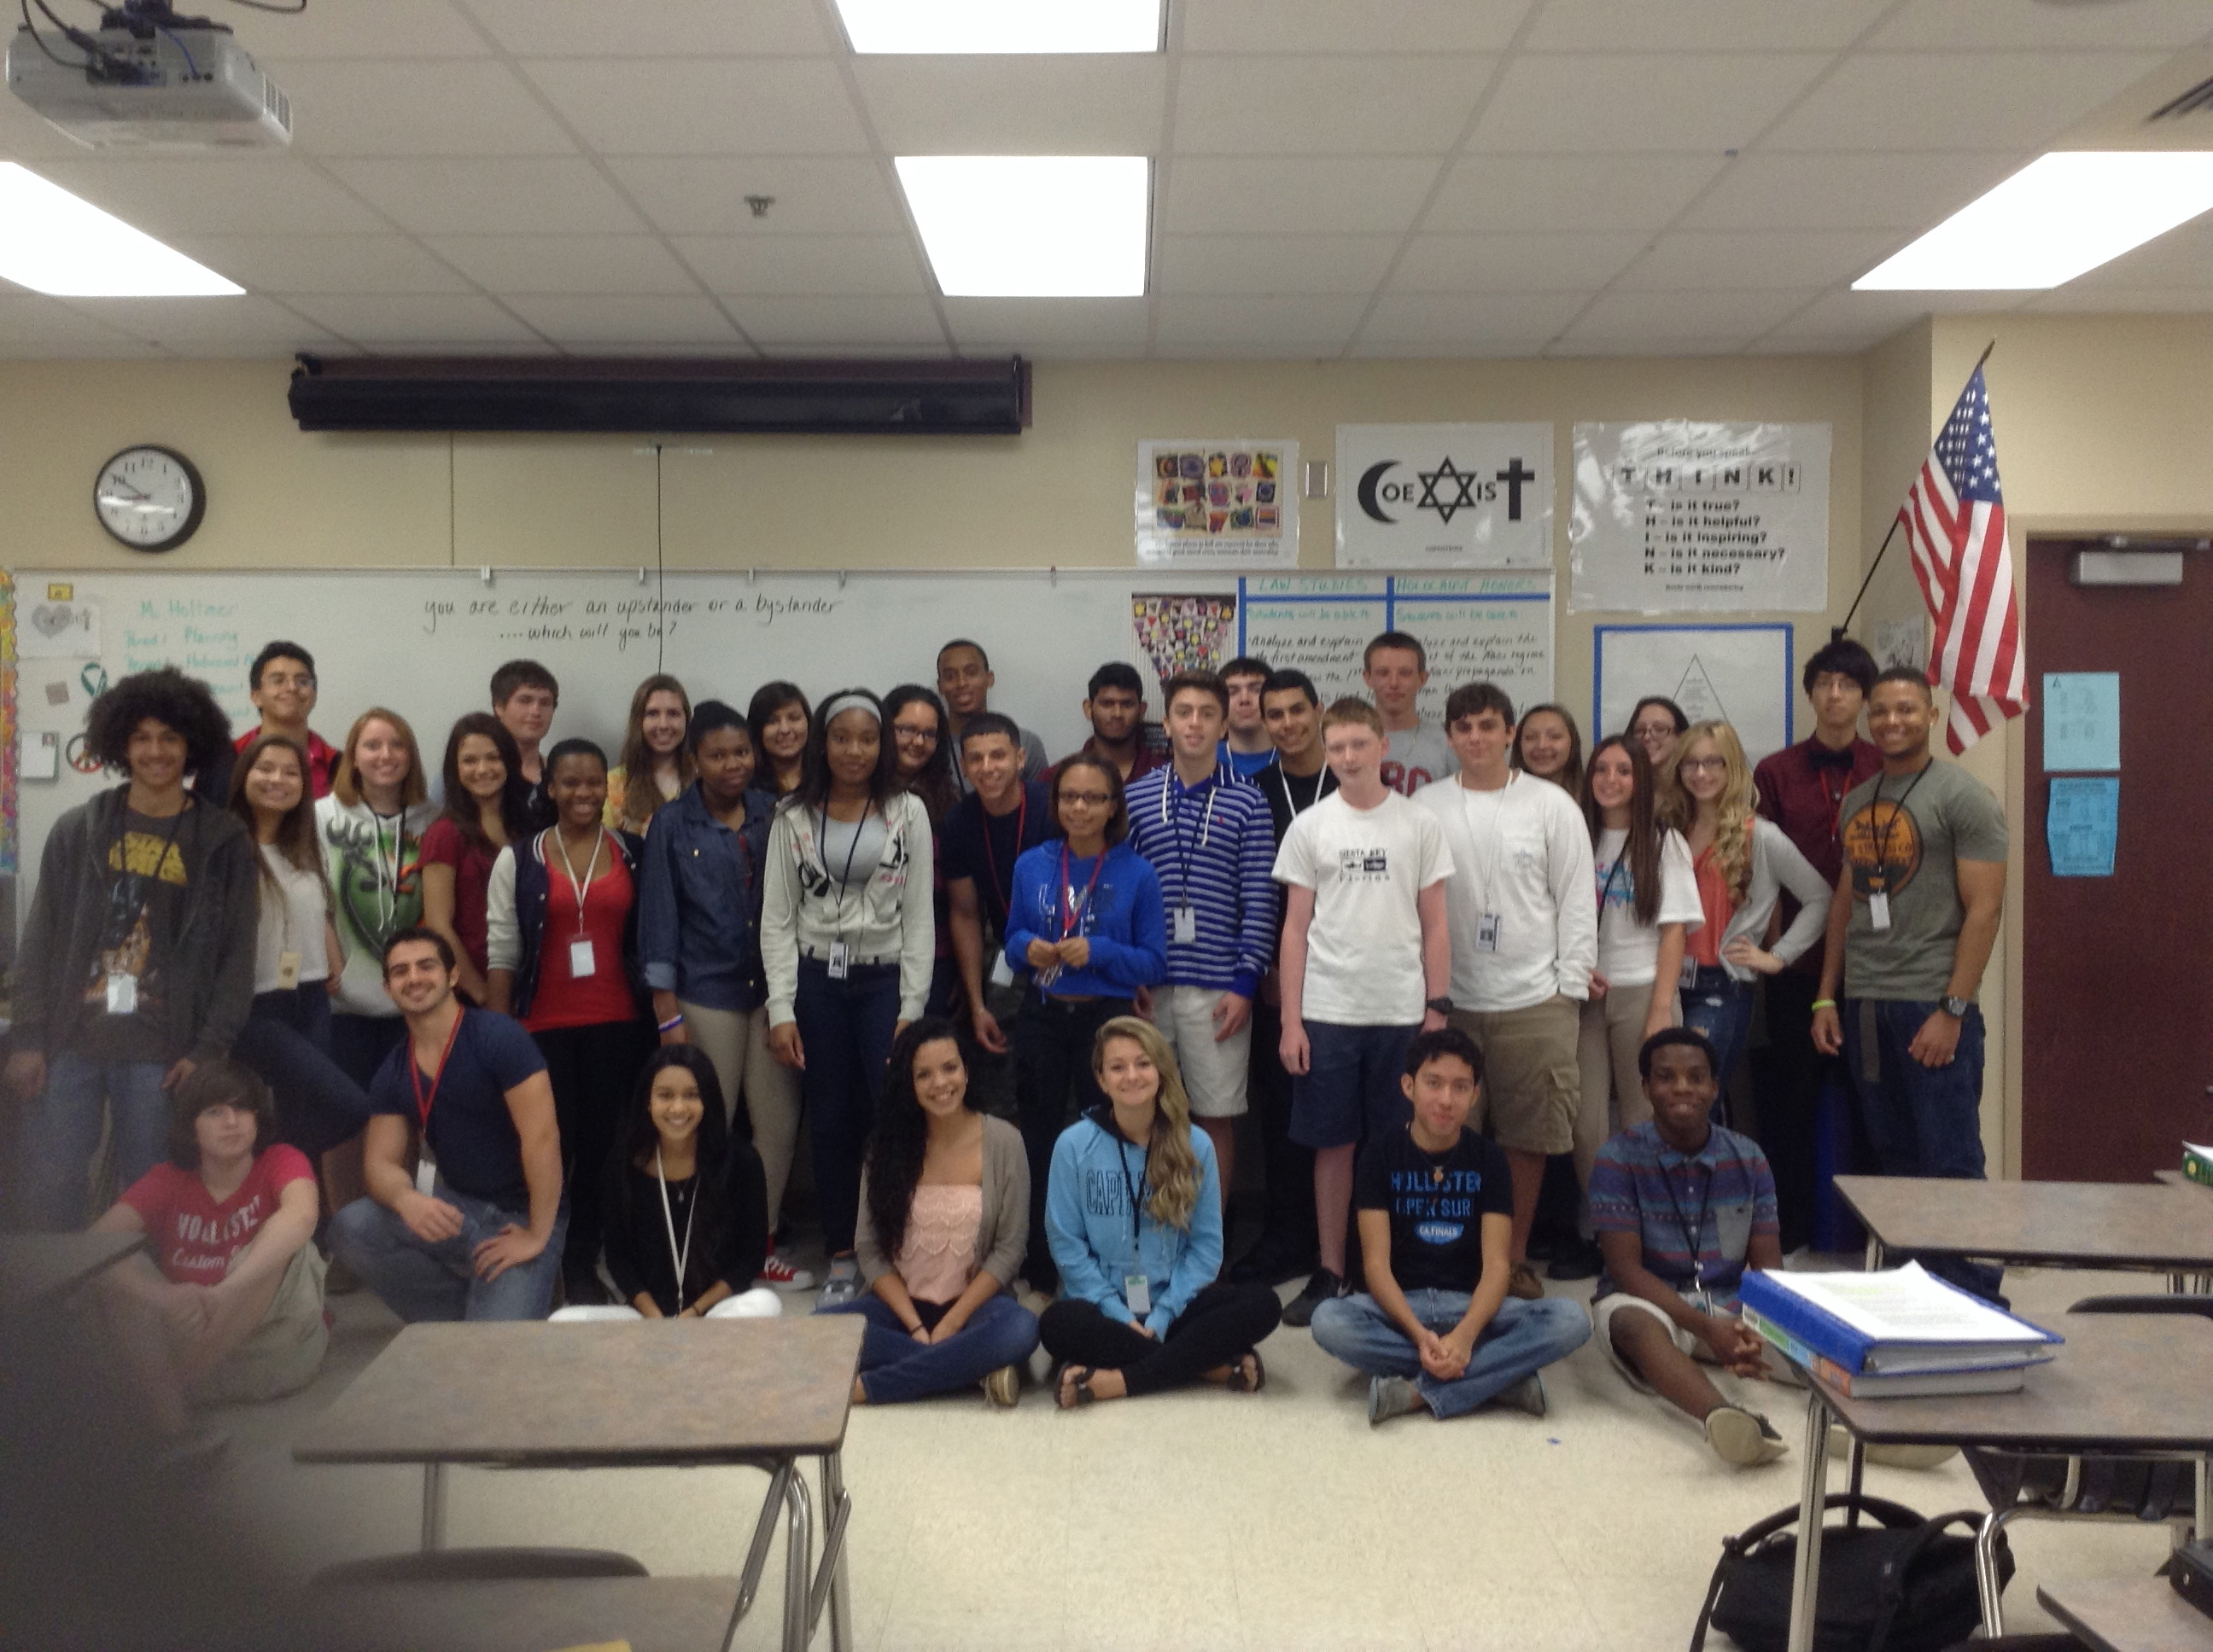
CENTRAL CLASSROOM PICTURES SHOWING STUDENT DIVERSITY

Slide 16
End of year events
Floods in Serbia
Central High Schools Video Message to their friends in Serbia
Testing
Graduation

Slide 17
THE PROJECT CONTINUES
Maureen: this was a pilot project for new course for next year. One main topic: how civil societies are created and destroyed – and how they can be rebuilt and sustained.
Marko: next year goal will be to shoot film about Jewish history in Nis, with help of American partners.
Senka: will connect survivors from Florida in Serbia.

