Slide 1
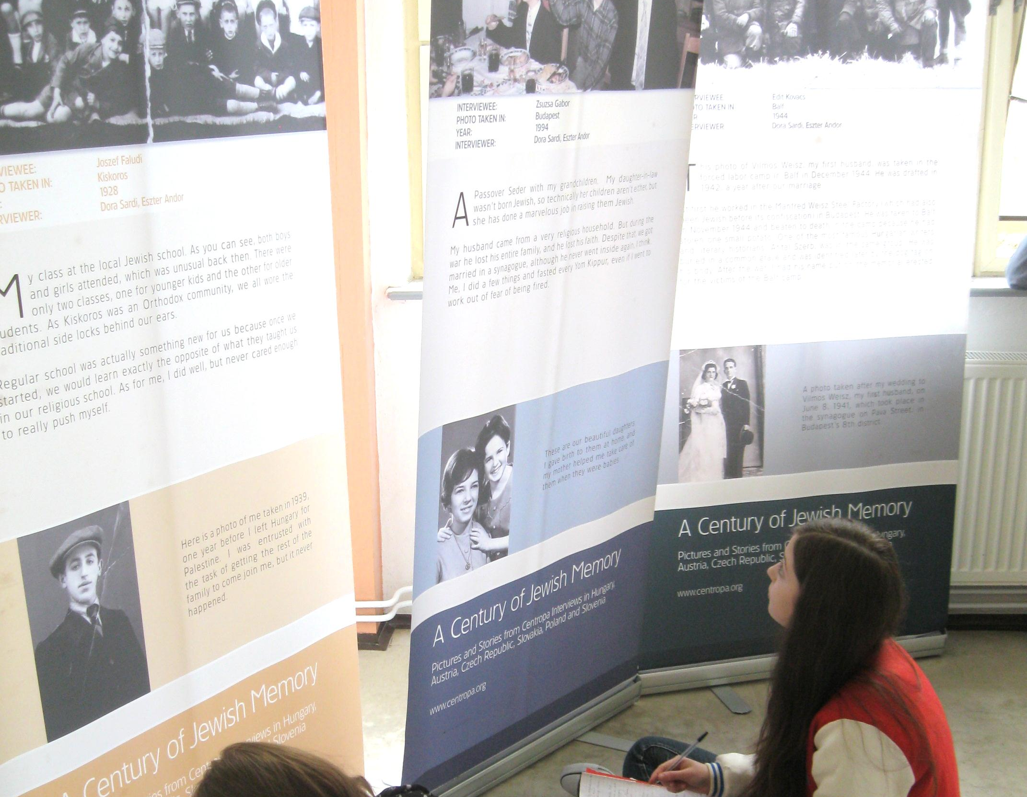
Secondary grammar school Andreja kmeťa and centropa
A century of Jewish Memory

Slide 2
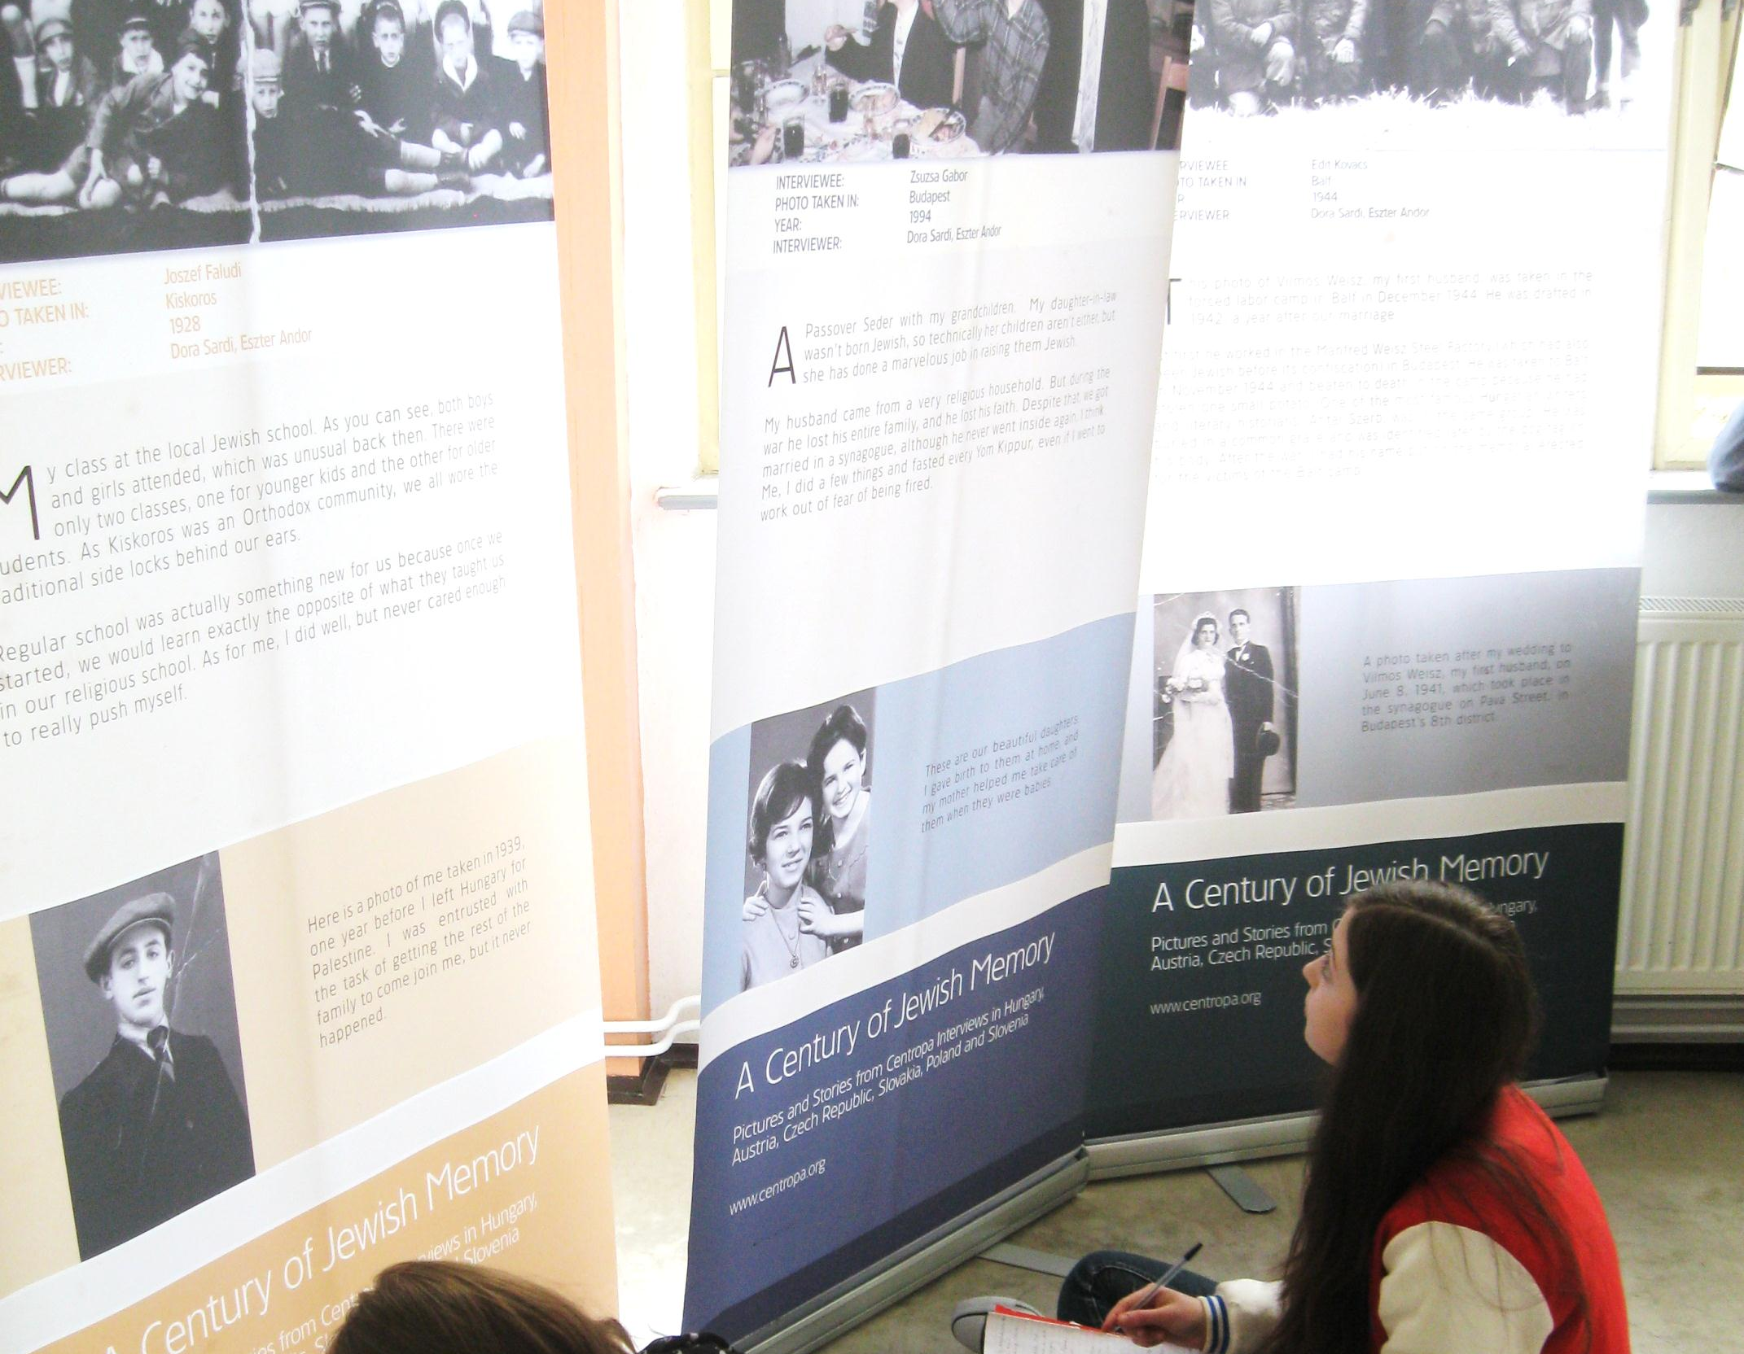
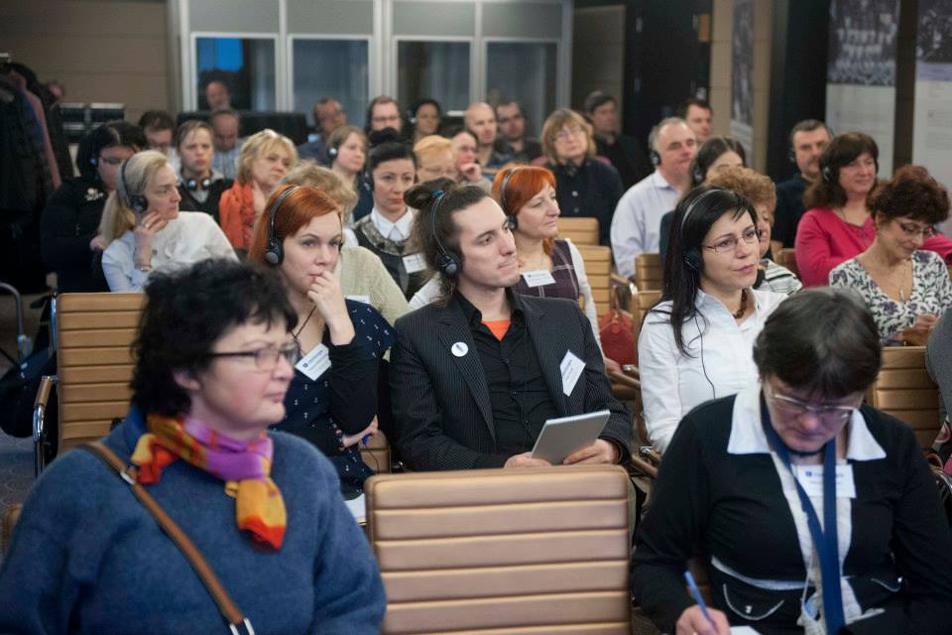
Budapest 2013
Exhibition A century of Jewish culture
My school - 250 students
Primary school of Jozefa Kollára
Two willing teachers vs lack of time!
Realization...
Parameters...
Inspiration...
...two weeks for preparation
location – foyer
2 weeks
Distribution of responsibilities
Tatiana Adamská (primary school)
- communication
- memory game
- marketing

Slide 3
Background
No knowledge
Stereotypes
Sensitive nature
Political and social atmosphere
Enlighten the roots of Slovak culture
Knowledge of Jewish culture
Show students no borders
Goal

Slide 4
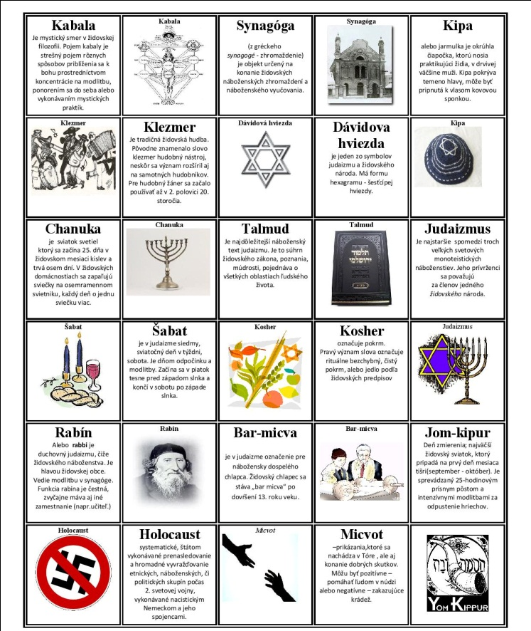
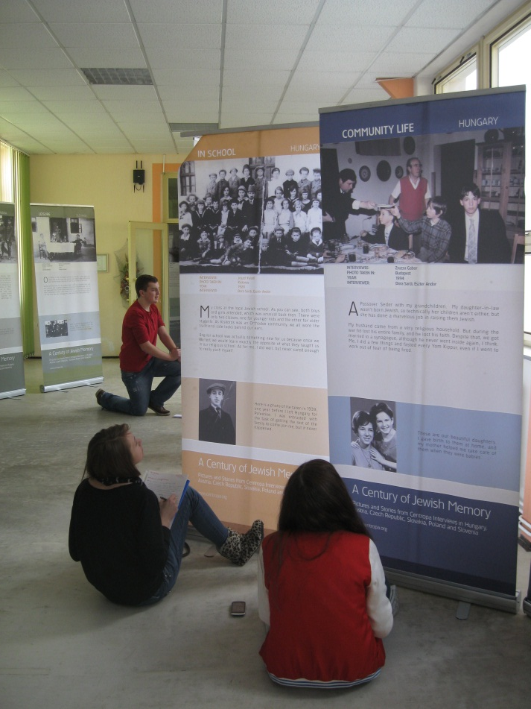
PS of J. Kollára:
-> pexeso
Secondary school:
-> article, school web
-> FB
-> a poster and bulletin
-> invitations for other schools
-> analyzes: Ethics, Introduction to humanities, English, Social studies, History
-> a design of exhibition
Realization continues...

Slide 5
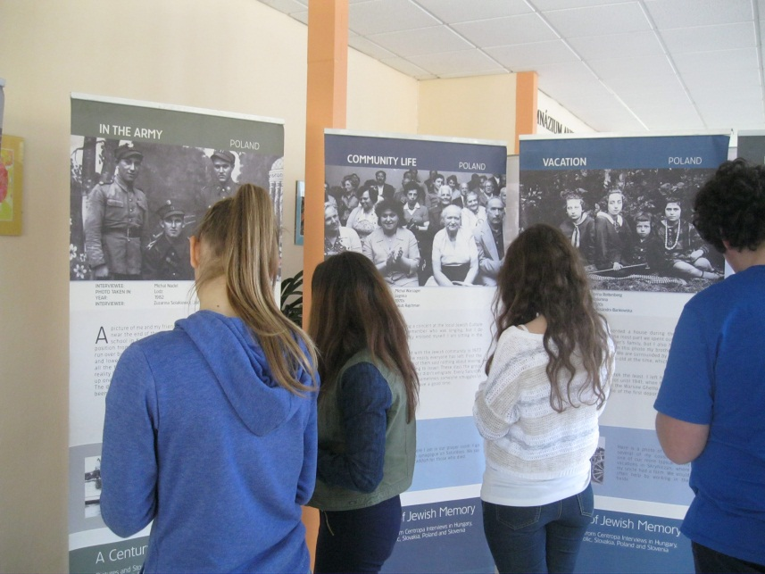
Work details in lessons:
English lesson: translation
IT lesson: Making of the bulletin
Social studies: Analyzing problems
History
Ethics: about tolerance -> variety -> Jewish culture -> other cultures, preparation of the exhibition´s guides
> Training and rehearsal
> Daily with the exhibition
Exhibition...

Slide 6
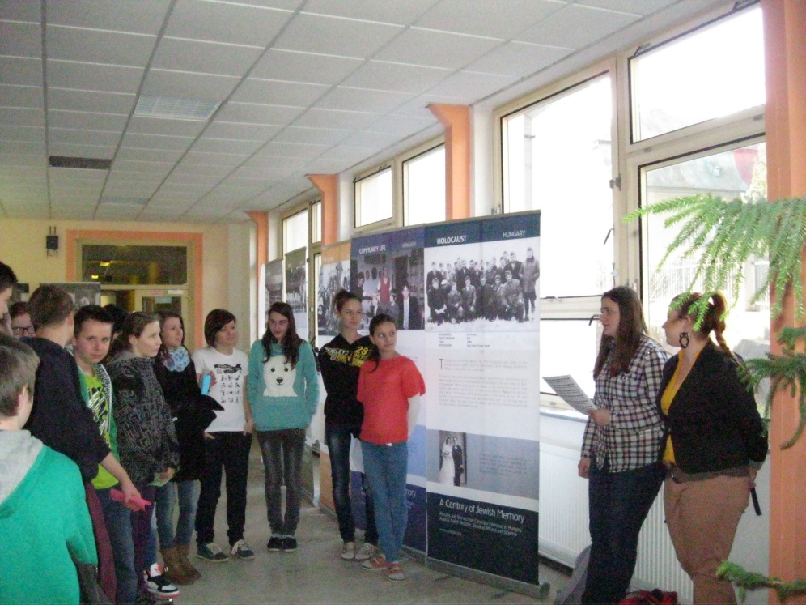
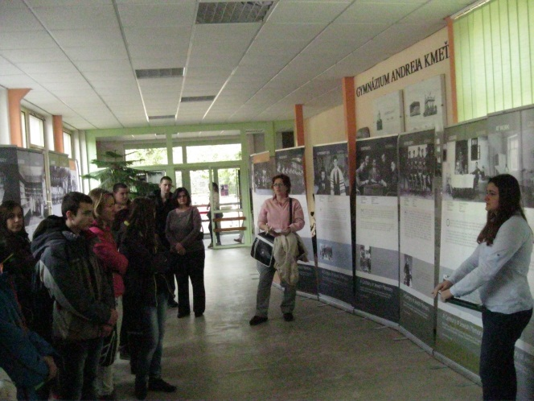
Exhibition - Public
Open 5 days
8 student´s guides
3 primary schools
45 min / around countries
Guides focused on pupils
-> visitors are active, communicate
-> pexeso as a gift
-> bulletin

Slide 7
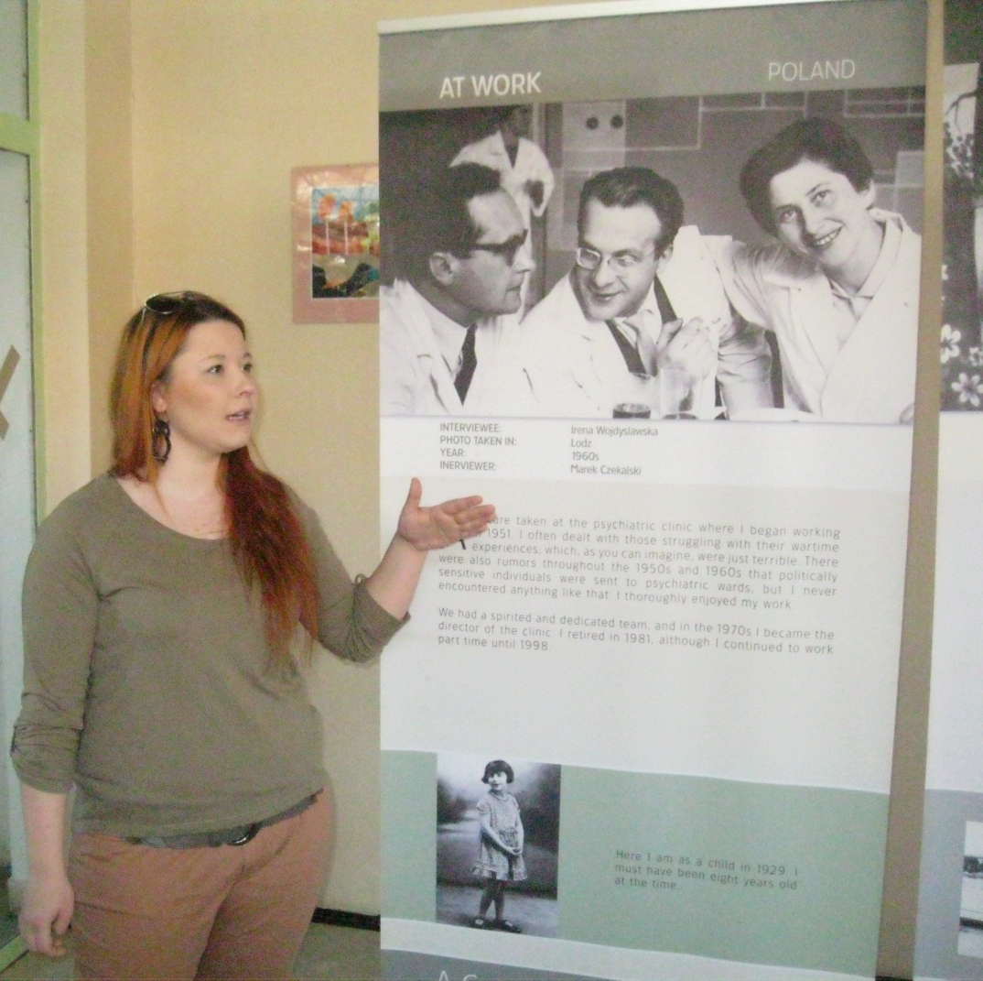
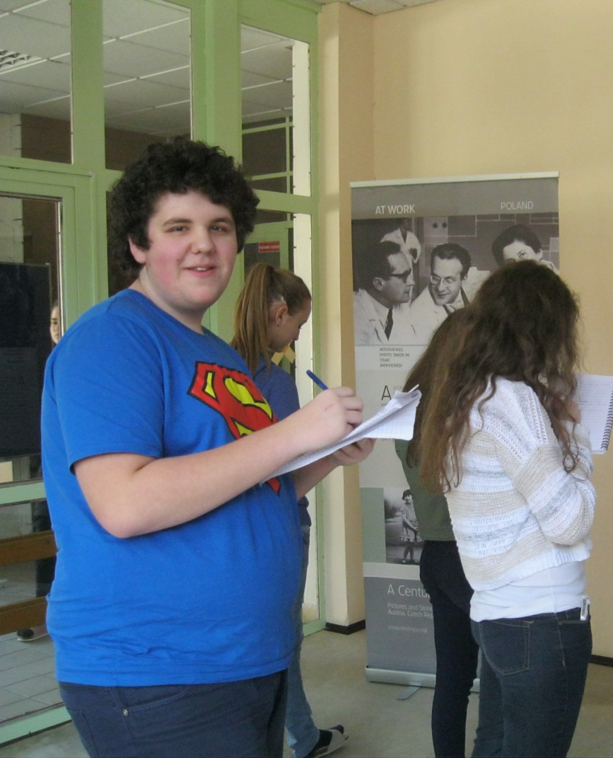
Success - inspiration
Students and visitors liked it
Knowledge of Jewish culture
New experiences
Acquaint with new topics and perspectives
Being proud of school and yourself
A will to do more projects
Unwilling colleagues
Weak marketing
More effective lesson plans
More precise preparation
Evaluation of local factors and society
Time
Problems - deficiency
Thank you

